Slide 1
West Contra Costa USD
2015 General Obligation Bond
Presentation to the Board of Education
March 18, 2015

Slide 2
I. 2015 General Obligation Bonds

Slide 3
2015 General Obligation Bonds
The District issued $135 million in general obligation bonds within the approved parameters.
Bonds were issued as $50 million Election of 2010, Series C, and $85 million Election of 2012, Series B, for a total of $135 million.
Fixed-rate current interest bonds, with 40-year final maturity
No capital appreciation bonds
Maximum underwriter’s discount of $5.25/bond.
The 2015 Bonds were structured to allow remaining debt service capacity for future bond issuances and to ensure that tax rates to not exceed $48 per $100,000 of AV, assuming 4% AV growth.
A longer final amortization of 40 years with current interest bonds were used to fit within debt service constraints once all bonds are issued and thus provide maximum future flexibility.

Slide 4
2015 General Obligation Bonds
The bonds generated $134.5 million of proceeds for projects in the District
All-in true interest cost of 4.05%
The financing used only current interest bonds – no capital appreciation bonds.
Sources
Bond Principal | $ 135,000,000
Bond Premium | $ 9,425,166
Total | $ 144,425,166
Uses
Project Fund | $ 134,515,425
Debt Service Fund | $ 8,716,416
Costs of Issuance | $ 1,193,325
Total | $ 144,425,166
Statistics
All-in true interest cost | 4.05%
Bond Principal | $ 135,000,000
Total Debt Service | $ 292,776,127
Final Maturity | 8/1/2054

Slide 5
Costs of Issuance Summary
Total costs of issuance was $484,575 for the $135 million transaction.
Professional Service | Costs of Issuance
Bond Counsel | $ 95,000
Disclosure Counsel | $ 85,000
Financial Advisor | $ 105,000
Paying & Escrow Agent | $ 3,000
Cal Muni | $ 2,075
Printing | $ 5,000
S&P Rating | $ 56,500
Fitch Rating | $ 55,000
Moody's Rating | $ 63,000
Miscellaneous | $ 15,000
Total | $ 484,575
Underwriter’s discount was $708,750.

Slide 6
Excellent Market Timing
Long-term general obligation bond rates at around the time of issuance were near historic lows.
Long-term interest rates have declined by approximately 75 basis points over the past year.
Bond Buyer-20 Index

Slide 7
Bond Pricing & Structure
 | Principal | Coupons | Yield | Spread
2016 | $ 2,985,000 | 2.00/3.00 | 0.41 | 0.27
2017 | 2,995,000 | 3.00/4.00 | 0.75 | 0.31
2018 | 3,010,000 | 4.00/5.00 | 1.11 | 0.34
2019 | 3,030,000 | 4.00/5.00 | 1.33 | 0.37
2020 | 1,550,000 | 4.00/5.00 | 1.50 | 0.37
2021 | 570,000 | 4.00 | 1.71 | 0.34
2022 | 595,000 | 5.00 | 1.95 | 0.35
2023 | 625,000 | 5.00 | 2.08 | 0.35
2024 | 655,000 | 5.00 | 2.28 | 0.31
2025 | 690,000 | 5.00 | 2.47 | 0.36
2026 | 725,000 | 5.00 | 2.74 | 0.43
2027 | 760,000 | 5.00 | 2.86 | 0.58
2028 | 800,000 | 5.00 | 3.00 | 0.58
2029 | 840,000 | 5.00 | 3.09 | 0.62
2030 | 880,000 | 5.00 | 3.15 | 0.64
2031 | 925,000 | 5.00 | 3.21 | 0.64
2032 | 2,795,000 | 5.00 | 3.22 | 0.65
2033 | 2,935,000 | 5.00 | 3.26 | 0.62
2034 | 3,080,000 | 5.00 | 3.30 | 0.62
2035 | 3,235,000 | 5.00 | 3.34 | 0.62
2040* | 18,780,000 | 5.00 | 3.45 | 0.64
2045* | 23,960,000 | 5.00 | 3.50 | 0.64
2054* | 58,580,000 | 4.00 | 4.08 | n/a
The 2015 bonds were structured with a combination of serial bonds through the first 20 years and larger term bonds on the back-end.
A 40-year final maturity priced with a 4.0% coupon yielding 4.08%.
Bonds are first callable on August 1, 2025.
*Term bonds subject to sinking fund.
Note: Spread to AAA MMD GO Index

Slide 8
Comparison to 30-Year Bonds
The 2015 Bonds were structured to mature in 40 years.
The net debt service differential between the 40-year bonds as issued and a 30-year bond financing is estimated at $11.5 million over the term of the bond.
The 2015 Bonds had a repayment ratio of 2.10x. This compares to an estimated ratio of 2.02x for a theoretical 30-year structure.
In 2013, the 2010 Measure D Bonds had a repayment ratio of 2.07x and the 2012 Measure E Bonds had a ratio of 2.06x.
 | Actual 40-Year Structure | Theoretical 30-Year Structure | Difference
Net Debt Service | $284,059,711 | $272,523,045 | $11,536,666
Principal Issued | $135,000,000 | $135,000,000 | 0
Repayment Ratio | 2.10x | 2.02x | 0.08x

Slide 9
2015 Pricing Compared to Prior Transactions
The District has issued general obligation bonds in separate issuances over the past few years.
The table below shows spreads to the AAA GO Index to the pricing of the bonds.
The 2015 Bonds generally priced favorably (with lower spreads) compared to the prior transactions.
Maturity | 2011 | 2012 | 2013 | 2014 | 2015
1 | 35 | - | 12 | - | 27
2 | 60 | - | 1 | - | 31
3 | - | - | 25 | 12 | 34
4 | - | - | 35 | 14 | 37
5 | - | - | - | 14 | 34
6 | - | - | - | 23 | 35
7 | - | - | - | 29 | 35
8 | - | - | 48 | 36 | 31
9 | 129 | 106 | 58 | 41 | 36
10 | 131 | 114 | 68 | 50 | 43
11 | 132 | 113 | 79 | 55 | 58
12 | 137 | 120 | 83 | 60 | 58
13 | 134 | 120 | 88 | 61 | 62
14 | 143 | 120 | 93 | 66 | 64
15 | 142 | 120 | 98 | 67 | 64
16 | 142 | - | 90 | 67 | 65
17 | - | - | 90 | 67 | 62
18 | - | - | 90 | 70 | 62
19 | - | - | 90 | 67 | 62
20 | - | 115 | 90 | 67 | 62
21 | 119 | - | - | 68 | -
22 | - | - | - | - | -
23 | - | - | - | - | -
24 | 117 | - | - | - | -
25 | - | - | - | - | 64
26 | - | - | 82 | - | -
27 | - | - | - | - | -
28 | - | - | - | - | -
29 | - | - | 103 | - | -
30 | 117 | - | - | - | 64
31 | - | - | - | - | -
32 | - | - | 106 | - | -
Note: Spread is to stated reoffering yield. Differences in coupons affect yield comparisons.

Slide 10
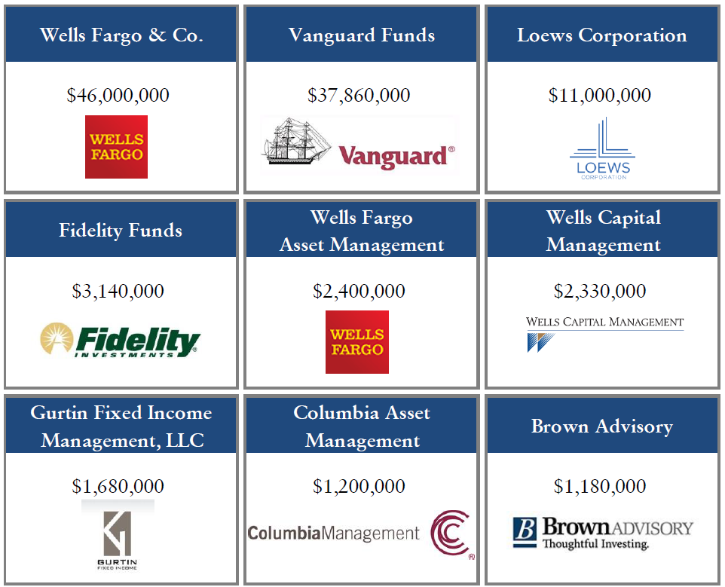
2015 Bond Investors
The 2015 transaction received orders from a core group of institutional investors, as summarized below.

Slide 11
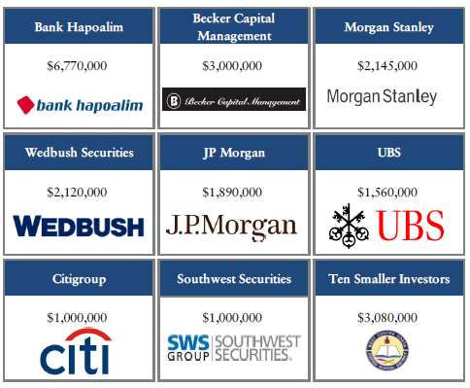
2015 Bond Investors (con’t)
The financing also attracted professional wealth management companies.

Slide 12
II. Plan of Finance

Slide 13
Current Plan of Finance
The current plan of finance assumes issuance of bonds in alternating years.
Both the Election of 2010 and Election of 2012 will have $190 million in remaining bond authorization, totaling $380 million.
The current plan of finance assumes a $48 tax levy and 4.0% annual AV growth.
Year | Series | 2010 Measure D | 2012 Measure E | Total
 | Previously Issued | $140,000,000 | $85,000,000 | $225,000,000
2014-15 | Elec. 2010 Ser. C Elec. 2012 Ser. B | 50,000,000 | 85,000,000 | 135,000,000
2016-17 | Elec. 2010 Ser. D Elec. 2012 Ser. C | 60,000,000 | 65,000,000 | 125,000,000
2018-19 | Elec. 2010 Ser. E Elec. 2012 Ser. D | 65,000,000 | 60,000,000 | 125,000,000
2020-21 | Elec. 2010 Ser. F Elec. 2012 Ser. E | 44,714,718 | 56,963,559 | 101,678,277
2045 | Elec. 2010 Ser. G Elec. 2012 Ser. F | 20,285,282 | 8,036,441 | 28,321,723
 |  | $380,000,000 | $360,000,000 | $740,000,000
Issuance amounts are subject to change based on future A.V. growth, market conditions, interest rates at the time of sale, and structure assumptions. Bonds after the 2015 issuance may be required to use AB 182 compliant capital appreciation bonds and/or the use of Bond Anticipation Notes.

Slide 14
Election of 2012 Debt Structure
Over time, the Election of 2012 bonds will be structured to meet projected tax revenue constraints based on 4% AV growth and tax rate of $48/$100,000 of AV.
Election of 2012 – Debt Service
Issuance amounts are subject to change based on future A.V. growth, market conditions, interest rates at the time of sale, and structure assumptions. Bonds after the 2015 issuance may be required to use AB 182 compliant capital appreciation bonds and/or the use of Bond Anticipation Notes.
Certain amounts of rate stabilization funds or debt service funds are used to offset debt service.

Slide 15
Election of 2010 Debt Structure
Over time, the Election of 2010 bonds will be structured to meet projected tax revenue constraints based on 4% AV growth and tax rate of $48/$100,000 of AV.
Election of 2010 – Debt Service
Issuance amounts are subject to change based on future A.V. growth, market conditions, interest rates at the time of sale, and structure assumptions. Bonds after the 2015 issuance may be required to use AB 182 compliant capital appreciation bonds and/or the use of Bond Anticipation Notes.
Certain amounts of rate stabilization funds or debt service funds are used to offset debt service.

